Slide 1
Coding Center of Excellence Design Pattern: Mediator

Slide 2

Mediator Design Pattern Overview
Also known as: Intermediary, Controller.
This design pattern is useful when there are several objects trying to communicate with each other during the execution of a program. To prevent communication chaos and restrict interactions between the objects, they must communicate through a Mediator object.

Slide 3
Type: Behavioral
Motivation
Applicability
Structure
Participants
Collaborations
Consequences
Implementation
Code Samples
Mediator
Agenda

Slide 4
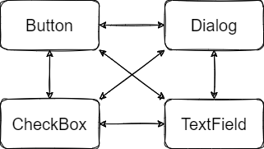
Type: Behavioral
Mediator
Motivation

Slide 5
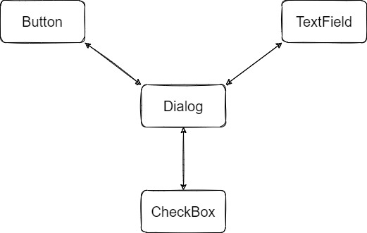
Type: Behavioral
Mediator
Applicability

Slide 6
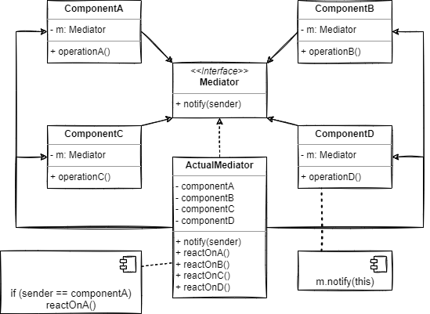
Type: Behavioral
Mediator
Structure

Slide 7
Type: Behavioral
- Mediator: Object that gets notified about the components behavior and also invokes behavior on the components.
- Component(s): Element that notifies the Mediator about its behavior and exposes behavior to be invoked.
Mediator
Participants

Slide 8
Type: Behavioral
Mediator
Several components can communicate with each other to collaborate on their tasks in an ordered fashion by notifying a Mediator about their tasks.
Collaborations

Slide 9
Type: Behavioral
Mediator
Over time, a mediator can become a God Object.
Consequences

Slide 10
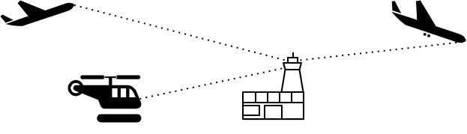
Type: Behavioral
Mediator
Implementation

Slide 11

Type: Behavioral
Mediator
Code Samples

Slide 12
Refactoring.Guru. (n.d.). Mediator. Retrieved January 25, 2022, from https://refactoring.guru/design-patterns/mediator
Diagrams: https://app.diagrams.net/
Github logo
References and
Resources

